Slide 1



Roosevelt Forest Tree Cover Type Prediction
Kevin McPherson
Flatiron School Module 3 Project
March 30, 2020

Slide 2
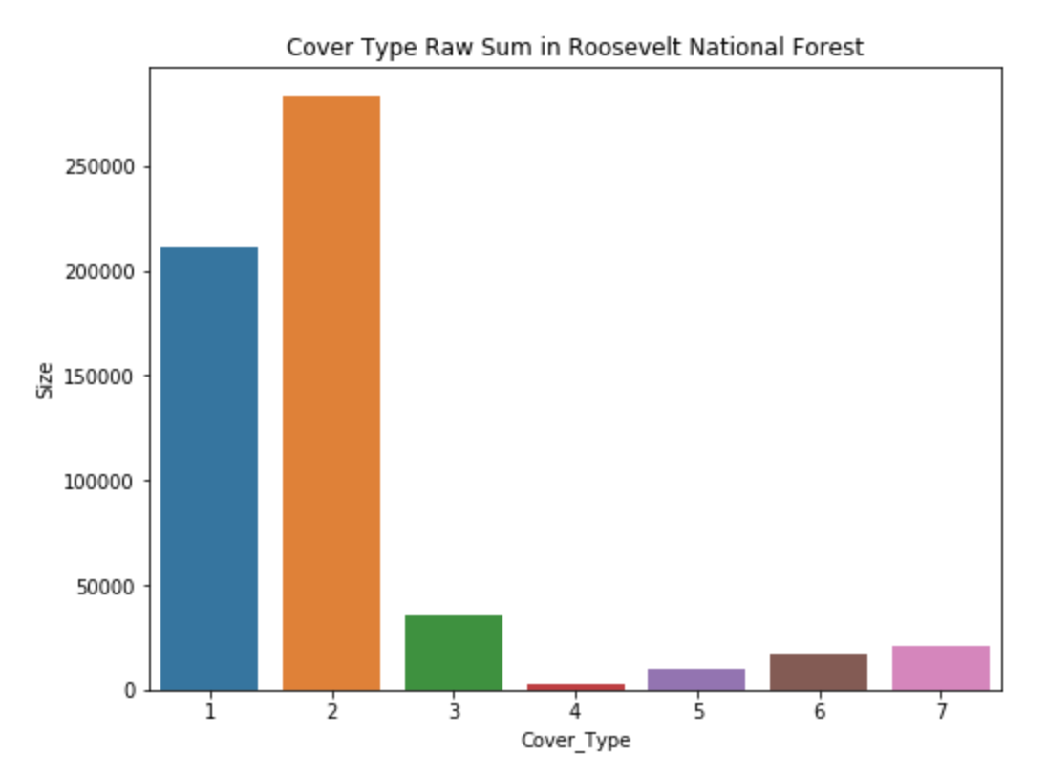
Introduction to the Data
Data is provided by the UCI Machine Learning Repository
Each row in the set represents a 30 x 30 sq. meter patch of forest
Cartographic features, rather than remote features (i.e., features from a satellite)
Heavy Spruce/Fir and Lodgepole Pine forests

Slide 3
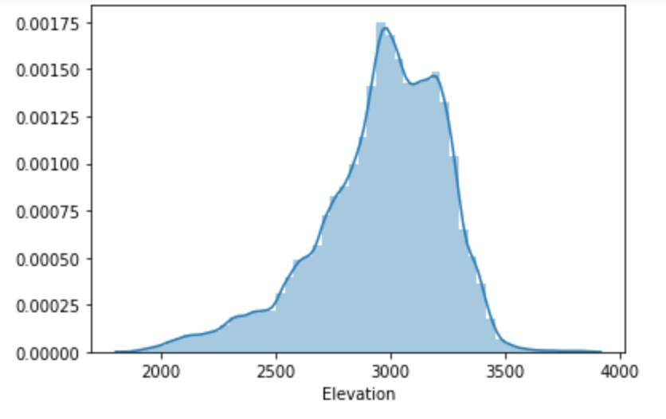

Slide 4
Roosevelt National Forest
Over 800,000 acres of total area
Separated into two different ranger districts

Slide 5
Future Work
Correct for horizontal distances to fire points; make a realistic Earth distance estimate.
Get a better representation of cover type in the data set.
Implement

Slide 6
Thank you for your time.
Are there any questions, comments or concerns?

